Slide 1



Yield
ORACLE
C7081
2021

Slide 2










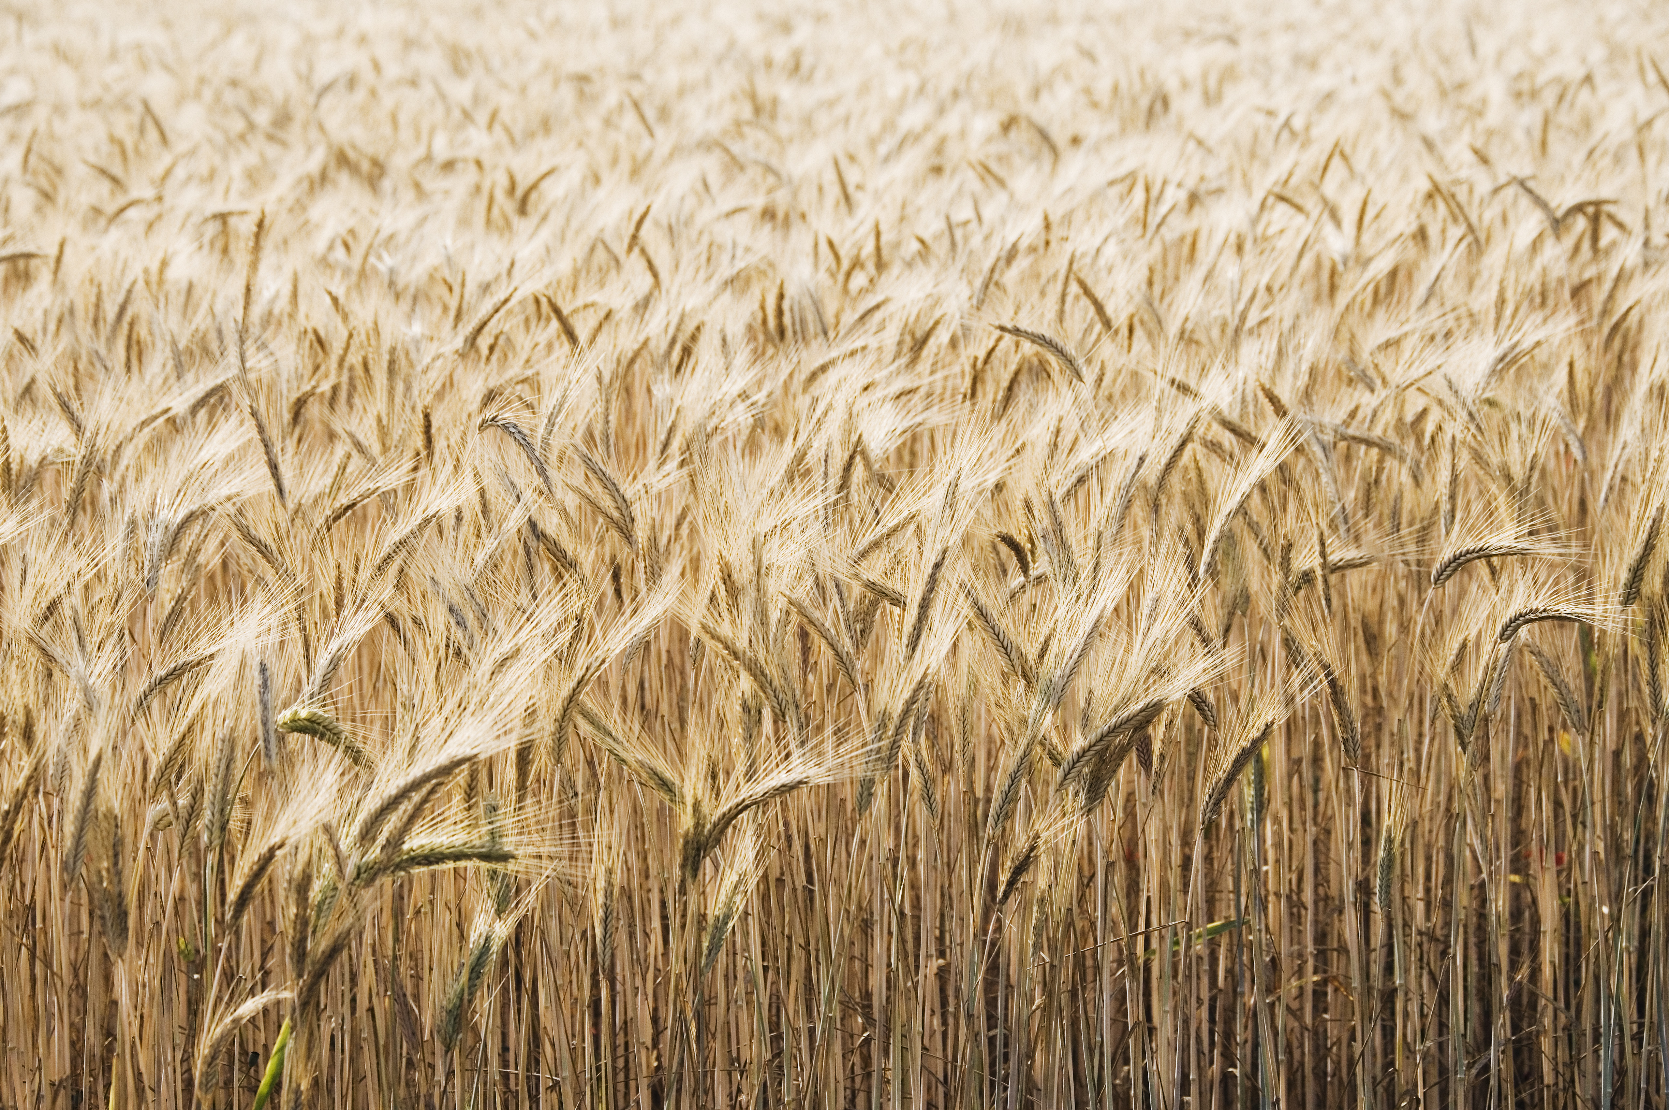


















Slide 3


Q
C7081
2021
antine

Slide 4
Q
antine
Q
antine

Slide 5


HARPE
D
D
HARPE
HARPE
T
T
A
A
2021
HA UG!
D
HARPE
T
2021
A

Slide 6
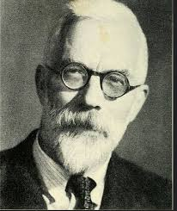


HARPE
HARPE
DATA
SCIENCE
HARPE
HARPE
DATA
SCIENCE

Slide 7

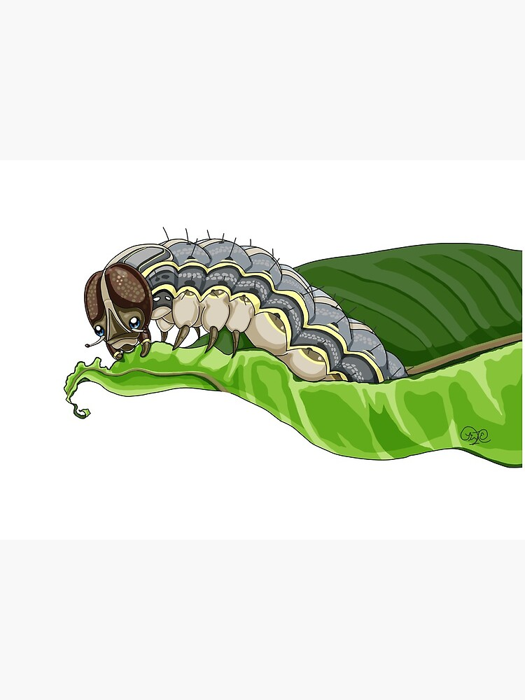
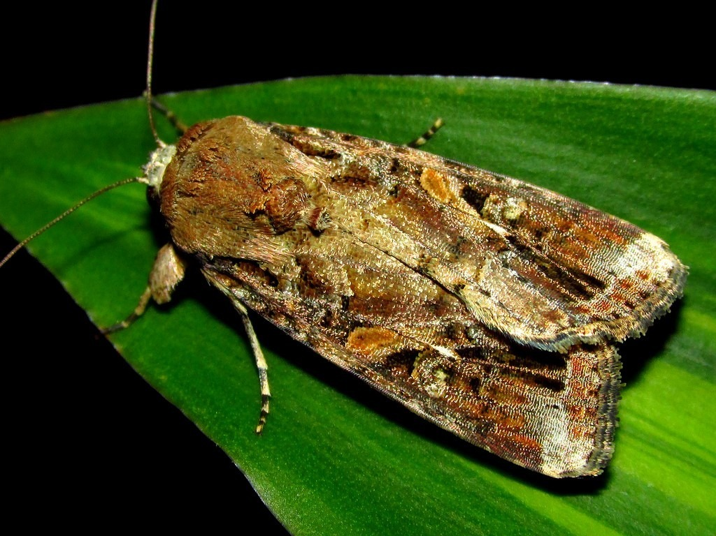






DS
EDA
2021
GA
AGE
DS
2021
DATA
SCIENCE
DS
GA
AGE

Slide 8




Slide 9

Viz!
Non-linear
HA UG
2022

Slide 10
Oh my!
Loops and lmer
HA UG
2022

Slide 11
Ch 04
Spatial Data
HA UG
2022

Slide 12
Ch 03
Spatial Data
HA UG
2022

Slide 13
Ch 01-02
Spatial Data
HA UG
2022

Slide 14
{leaflet}
Maps in R
HA UG
2022

Slide 15
Ch 03
Advanced R
HA UG
2022

Slide 16
Scrape the
Web!
Twitter data
HA UG
2022

Slide 17
Keras
in R!
Deep Learning
HA UG
2022

Slide 18
Control structures
and flow!
R programming
HA UG
2022

Slide 19
Memory use
Advanced R
HA UG
2022

Slide 20
Yolov5 for
Custom data!
HARPE
DATA
SCIENCE

Slide 21
Using SADIE
in R
Spatial data
HA UG
2022

Slide 22
Big Data Projects
HARPE
DATA
SCIENCE

Slide 23
Web Automation in R
Automation
HA UG
2022

Slide 24
Web Automation in R
Automation
HA UG
2022

Slide 25

Github webpage
R analysis

Slide 26
LME + blocking
R analysis

Slide 27


Data Viz

Slide 29
NLP
Sentiment analysis
HARPE
DATA
SCIENCE

Slide 30
Sample size?
R simulation

Slide 31
NLP basics
HARPE
DATA
SCIENCE

Slide 32
T-test
R Bootcamp
2.5

Slide 33
Regression
R Bootcamp
2.4

Slide 34
Correlation
R Bootcamp
2.3

Slide 35
Distributions
R Bootcamp
2.2

Slide 36
summarizing
data
R Bootcamp
2.1
HARPE
DATA
SCIENCE

Slide 37
HAP-E
Machine learning
concept
HARPE
DATA
SCIENCE

Slide 38
HAP-E
Stats basics
HARPE
DATA
SCIENCE

Slide 39
HAP-E
Data wrangling
HARPE
DATA
SCIENCE

Slide 40
HAP-E
Python graphs
HARPE
DATA
SCIENCE

Slide 41
HAP-E
Python setup
HARPE
DATA
SCIENCE

Slide 42
manipulating
data
R Bootcamp
1.5
HARPE
DATA
SCIENCE

Slide 43
R Bootcamp
1.4
HARPE
DATA
SCIENCE

Slide 44
R Bootcamp
1.3
HARPE
DATA
SCIENCE

Slide 45
Github
Website
HARPE
HARPE
DATA
SCIENCE
SCIENCE

Slide 46


R Bootcamp
0.0 overview
HARPE
HARPE
DATA
SCIENCE
SCIENCE

Slide 47
R Bootcamp
0.1 RStudio
HARPE
HARPE
DATA
SCIENCE
SCIENCE

Slide 48
R Bootcamp
1.1 R Syntax
HARPE
HARPE
DATA
SCIENCE
SCIENCE

Slide 49
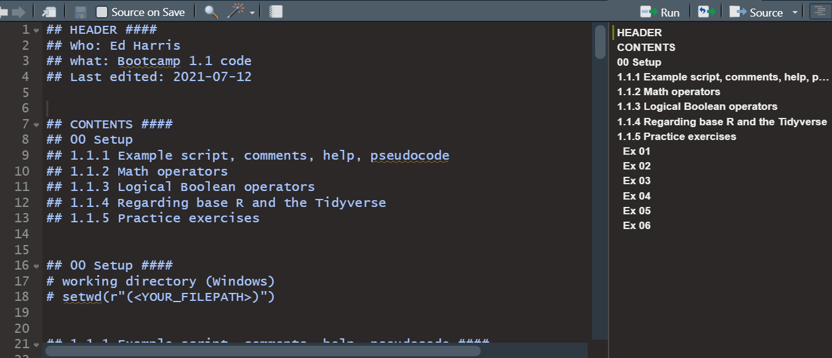
R Bootcamp
1.1 R Syntax
HARPE
HARPE
DATA
SCIENCE
SCIENCE

Slide 50
R Bootcamp
1.2 Functions
HARPE
HARPE
DATA
SCIENCE
SCIENCE

Slide 51
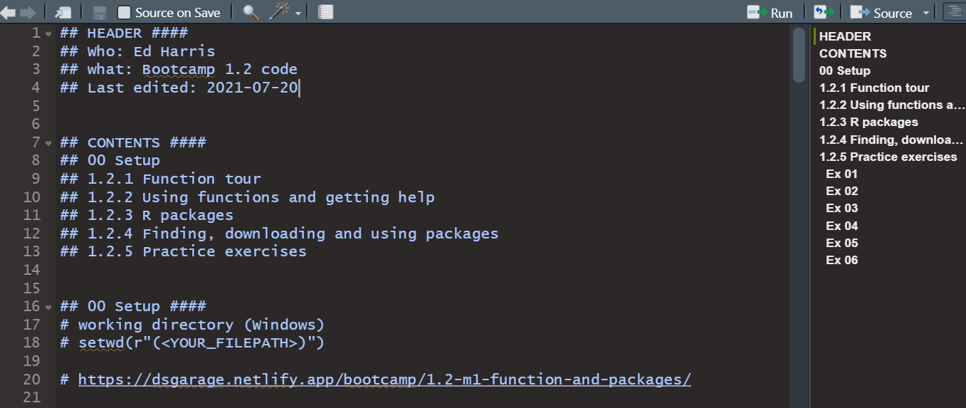
R Bootcamp
1.2 Functions
HARPE
HARPE
DATA
SCIENCE
SCIENCE

Slide 52

shinycustomloader
shinycustomloader
shinycustomloader
shinycustomloader
shinycustomloader
shinycustomloader
shinycustomloader
shinycustomloader
http://hexb.in/sticker.html

